Slide 1
Welcome to our Movie Reservation Platform presentation!
We’re excited to share how our system simplifies online ticket booking for moviegoers and cinema operators alike. Let's dive into the key features and innovations of our project.

Slide 2
Table of contents
1
6
Introduction
Project Demonstration
2
7
Project Organization
Testing
3
8
Hardware and Software Requirements
Limitations
4
9
System Architecture
Conclusion
5
Class Diagram
10
Team Contributions

Slide 3
Introduction
Cinema ticketing is transitioning to online booking.
Our platform ensures a seamless user experience.
Features a Laravel backend and JavaScript/CSS frontend.
Offers real-time seat selection and admin tools.

Slide 4
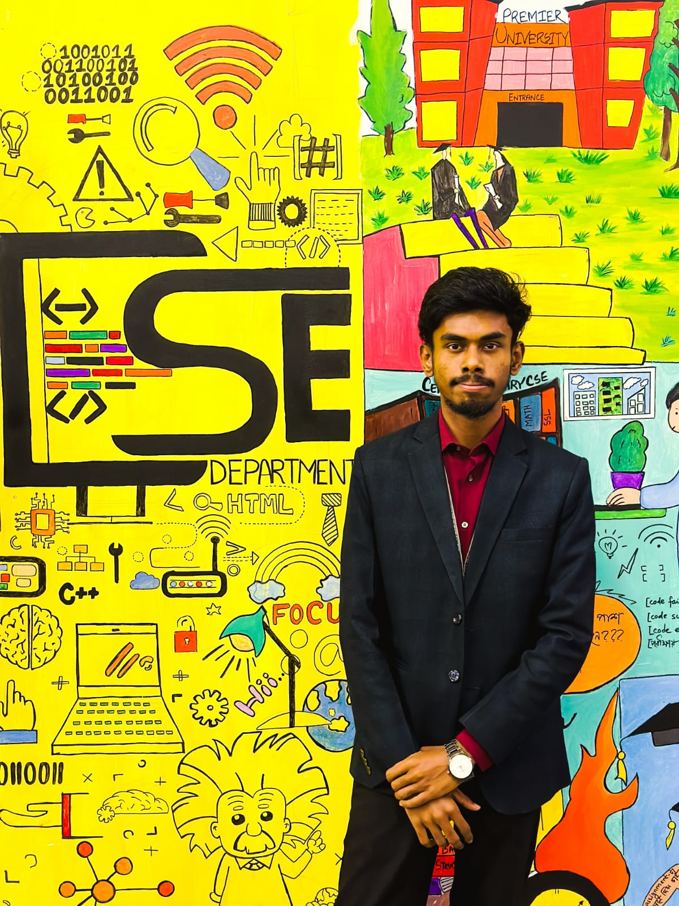
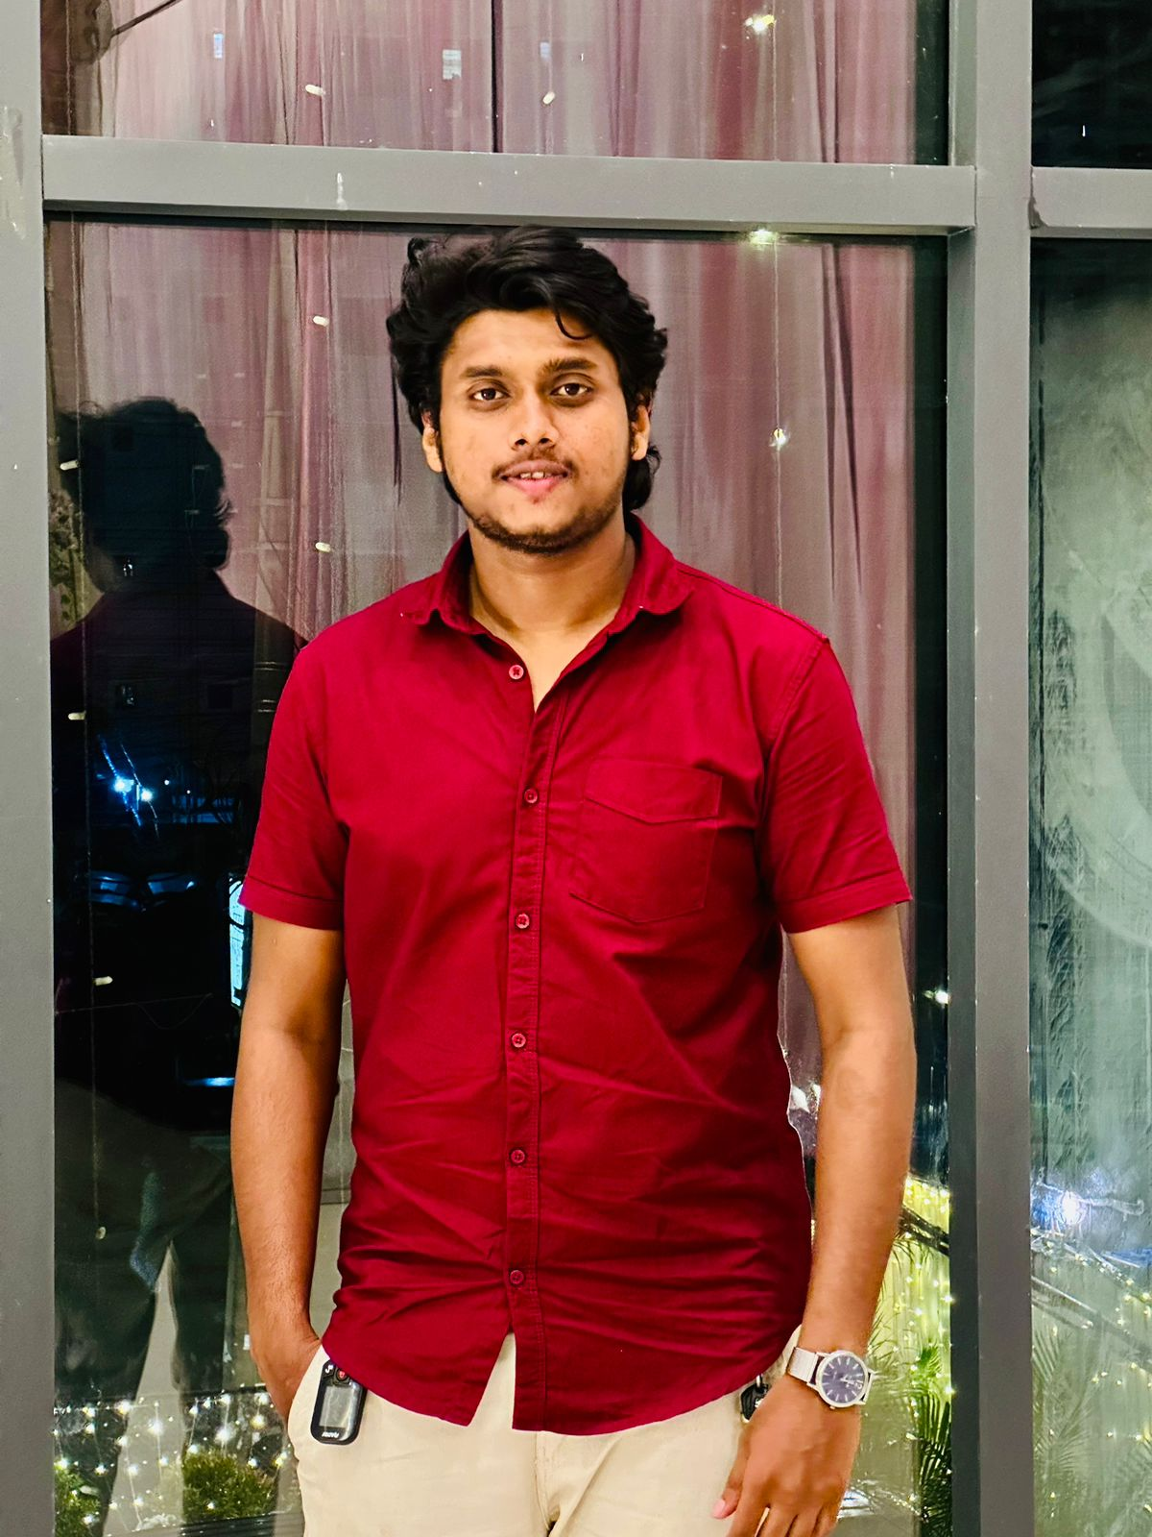
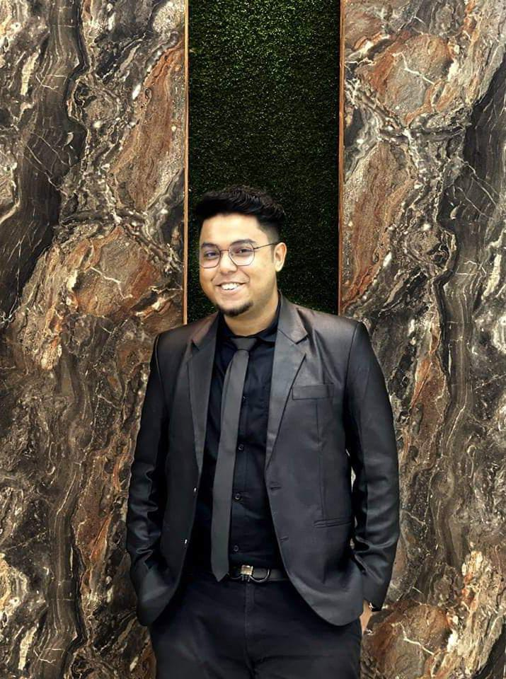
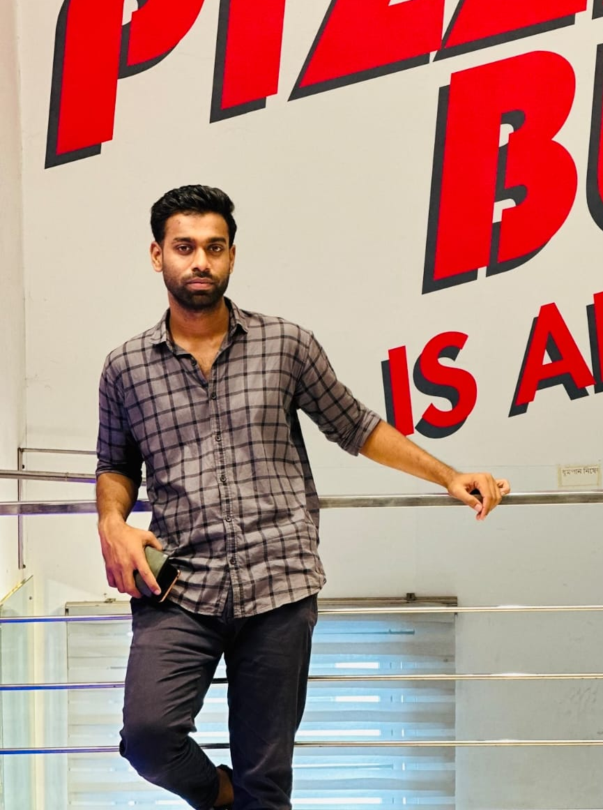
Team Introduction
Shovon Kanti Deb ID:2104010202243 | Poritosh Dey ID:2104010202274
Kishore Biswas ID:2104010202263 | Pranta Nath ID:2104010202238

Slide 5
Team Organization
Shovon Kanti Deb Developed the backend API for managing bookings. Coordinated the overall project timeline. Implemented backend security measures. | Poritosh Dey Developed the backend API for managing Built the responsive frontend for movie browsing, seat selection, and booking pages. Optimized frontend performance. Collaborated with the UI/UX designer to ensure design consistency.
Kishore Biswas Designed the UI wireframes and mockups. Conducted user research and usability testing. Led the design and implementation of the seat selection process. | Pranta Nath Designed and optimized the database schema for movies, showtimes, and bookings. Developed APIs for real-time seat selection and booking status.

Slide 6
Hardware and Software Requirements
Hardware
Software
PCs for development
Cloud or physical server for hosting
Backend:
Laravel
(PHP 7.4+)
Frontend: JavaScript, HTML, CSS
Database: XAMPP
(Apache, MySQL)
Tools: Composer, Git

Slide 7
System Architecture
Presentation Layer
Data Layer
Application Layer
JavaScript, HTML, CSS frontend
MySQL (XAMPP) and caching (Redis/Memcached)
Laravel for business logic and APIs

Slide 8
System Architecture
Key Components
User interaction via frontend
Backend APIs for logic and booking
Database for storing user and movie data

Slide 9
Limitations
Limited support for advanced seating options (e.g., VIP, accessible).
No integrated payment gateway at this stage.
Needs further scaling for large cinemas with complex seating.

Slide 10
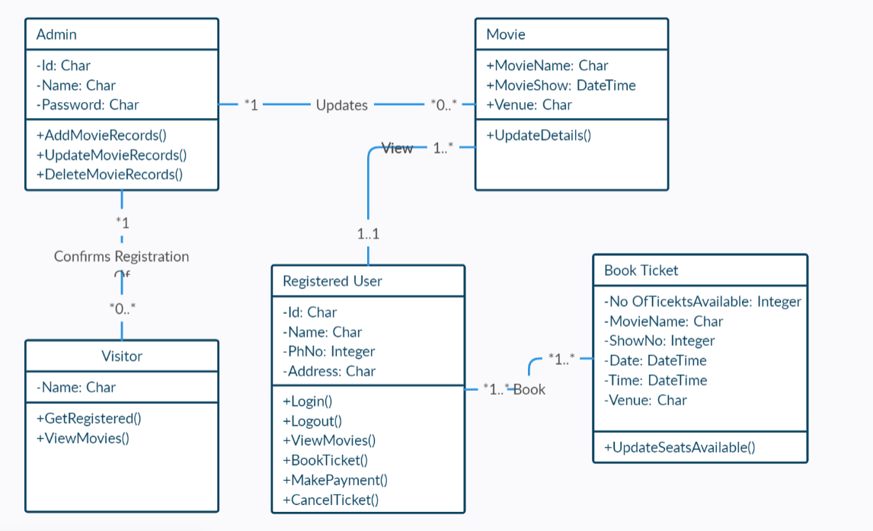
Class Diagram

Slide 11
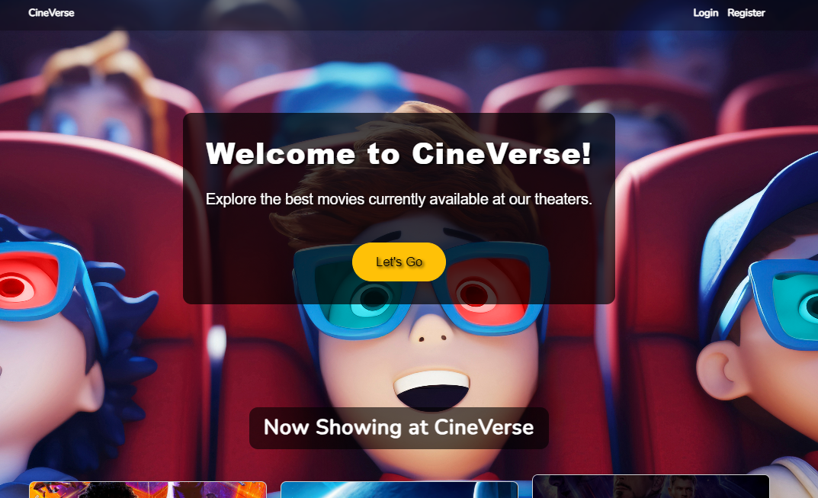

Slide 12
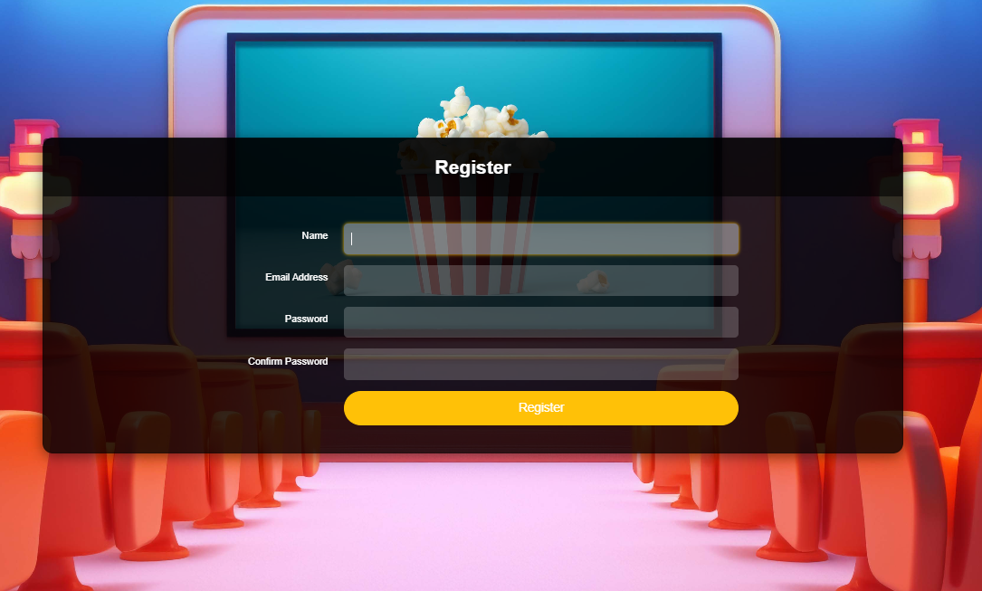

Slide 13
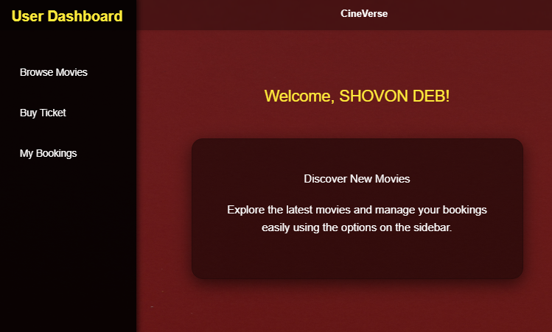

Slide 14
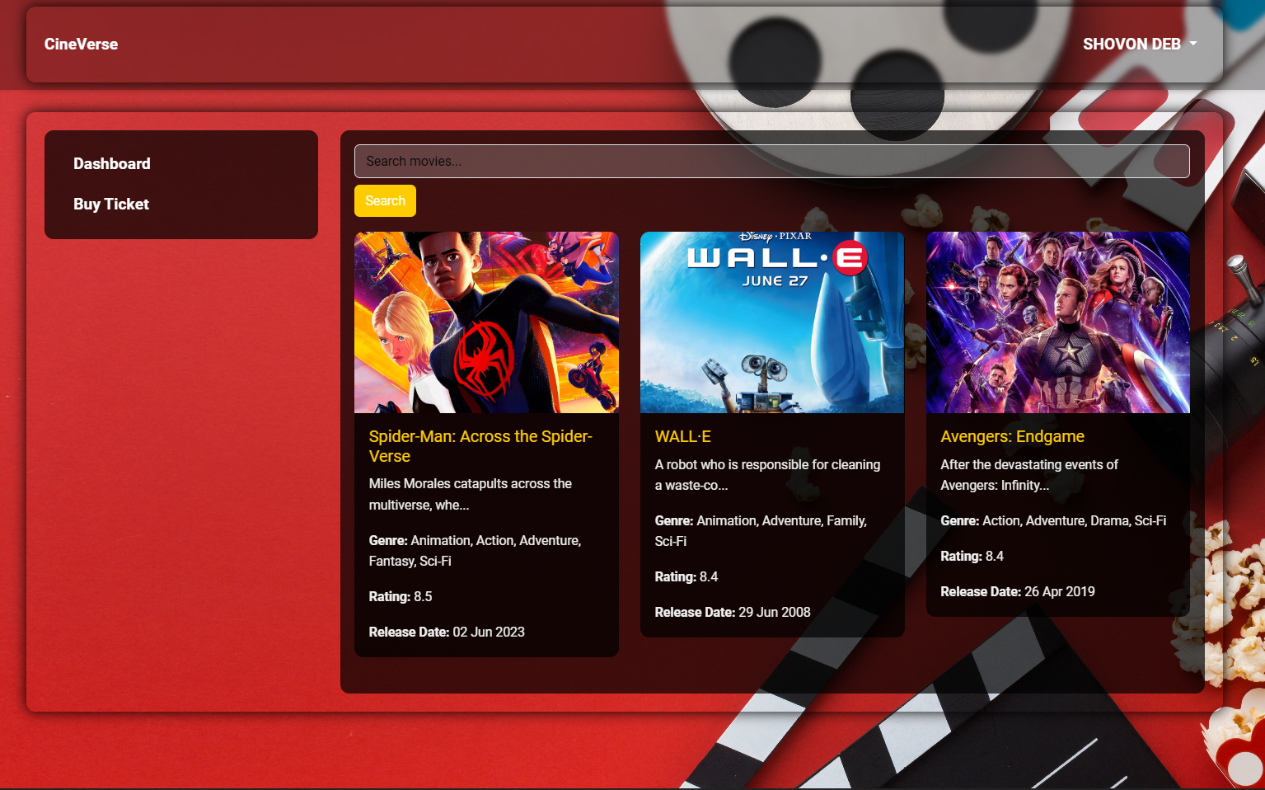

Slide 15
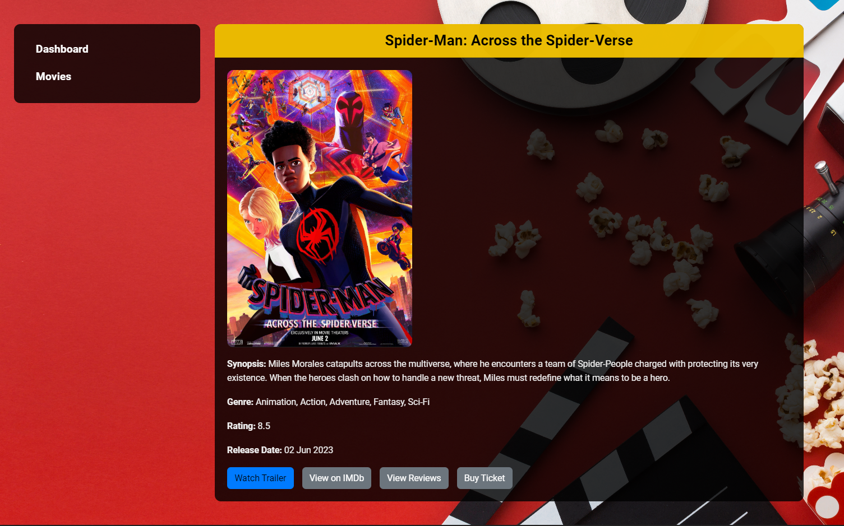

Slide 16
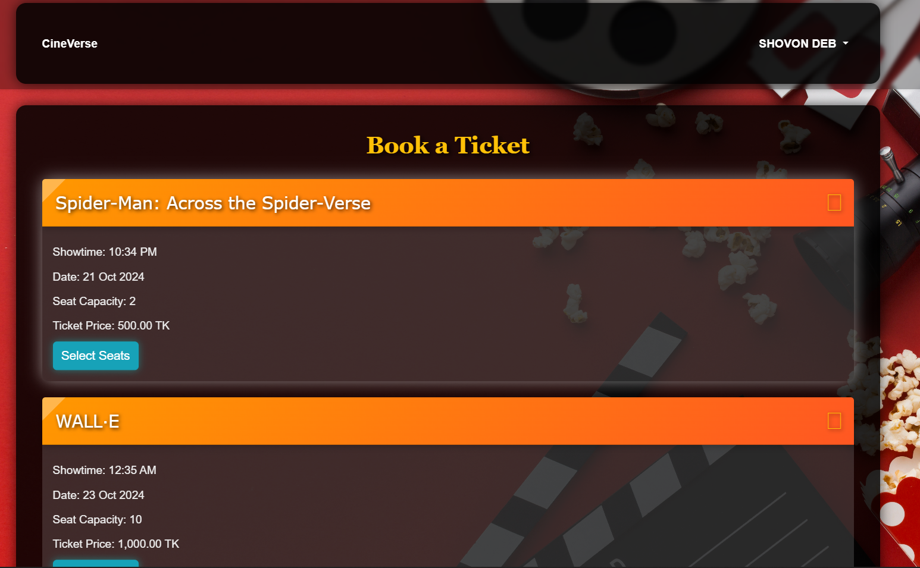

Slide 17
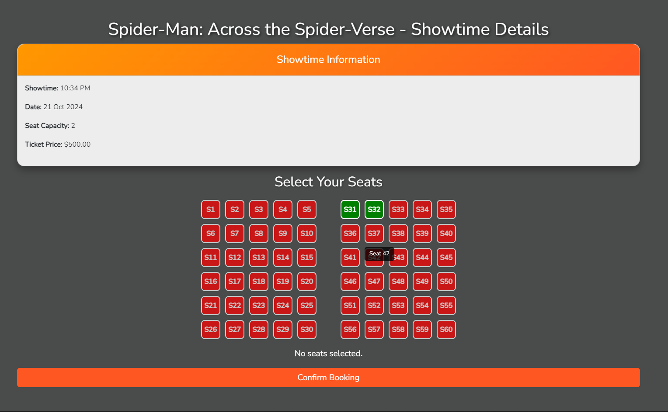

Slide 18
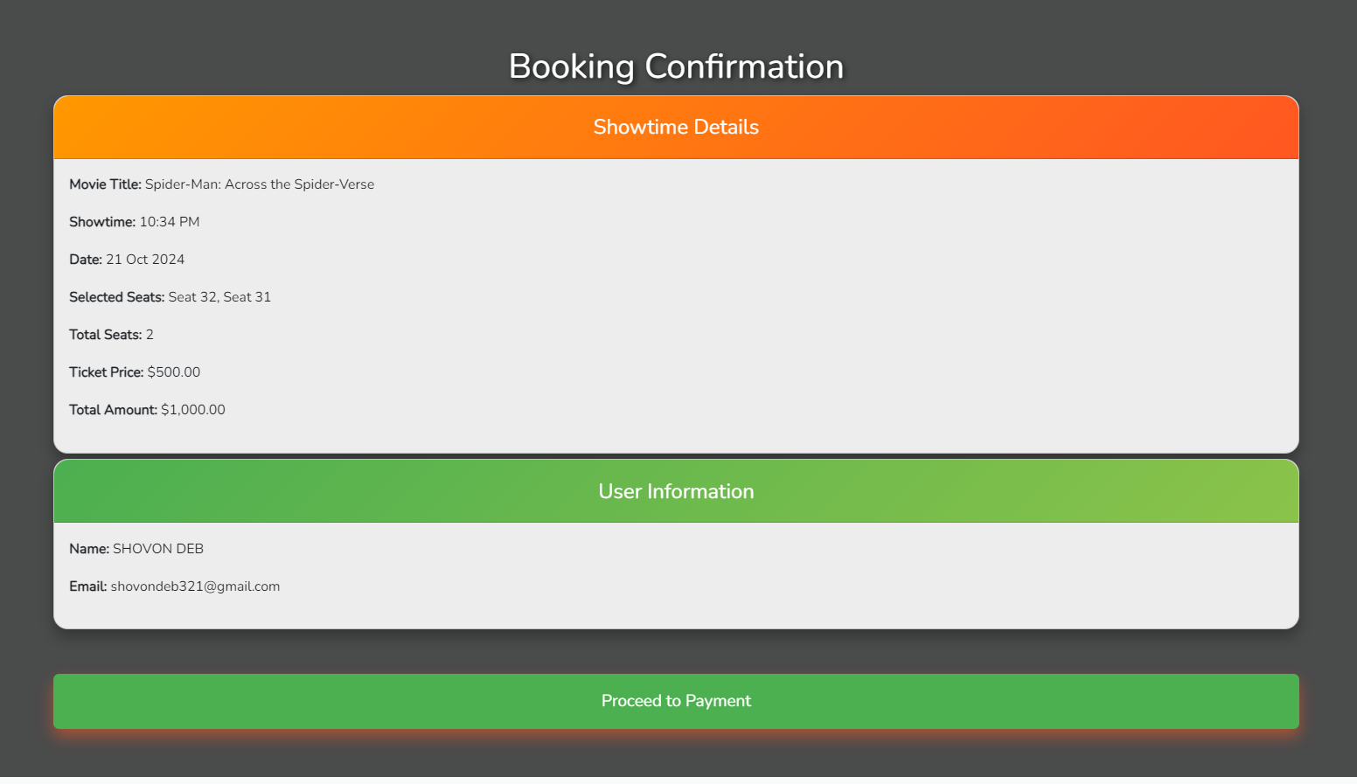

Slide 19
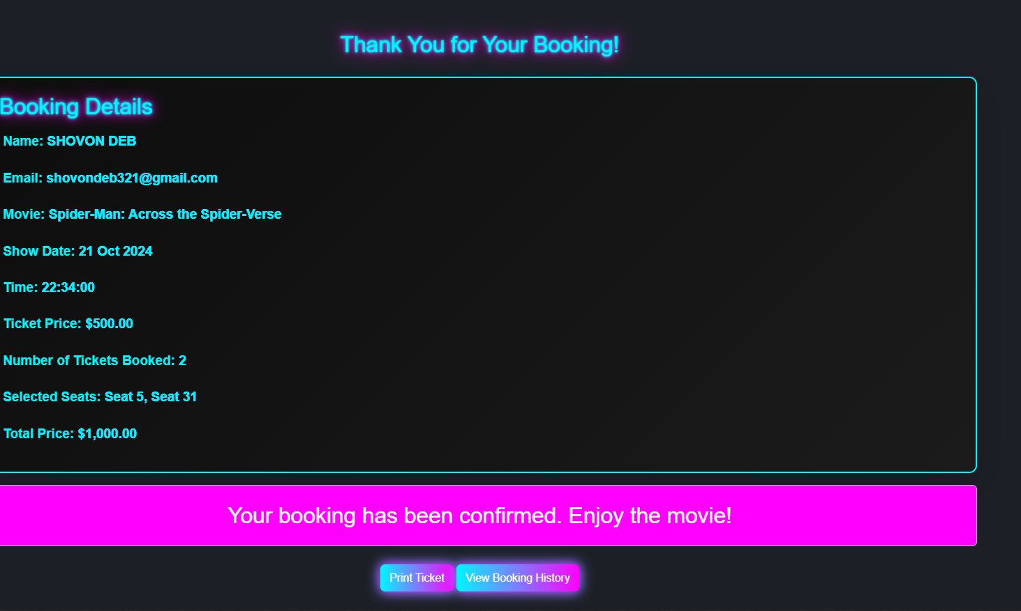

Slide 20
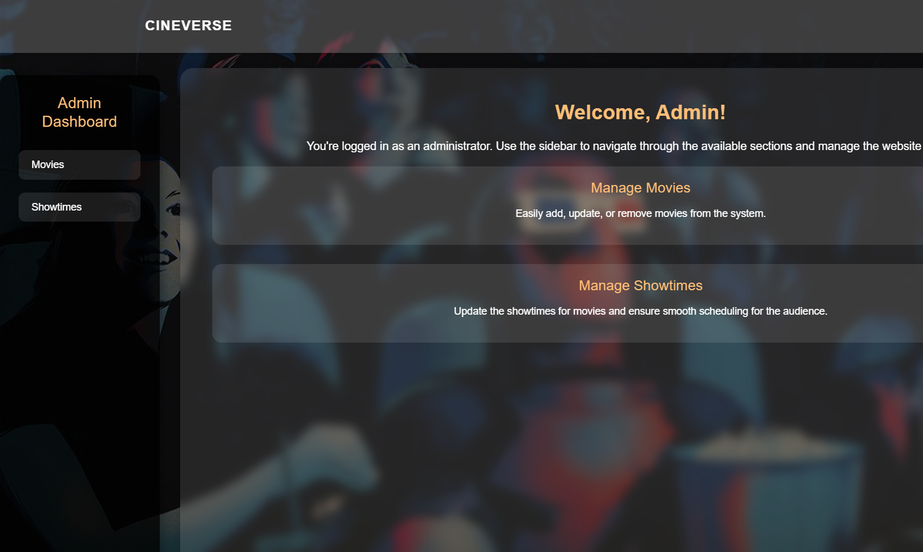

Slide 21
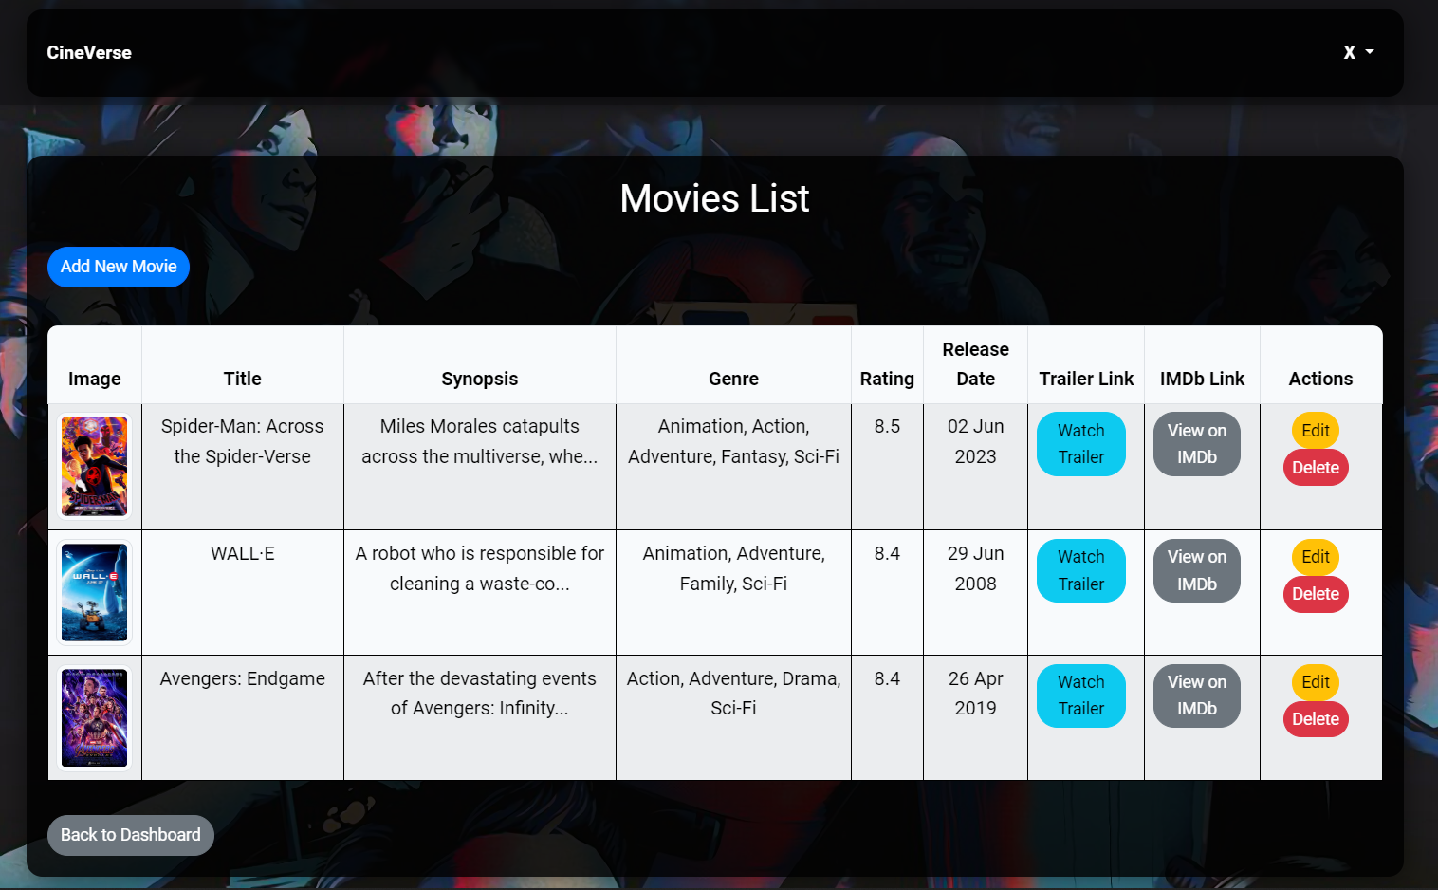

Slide 22
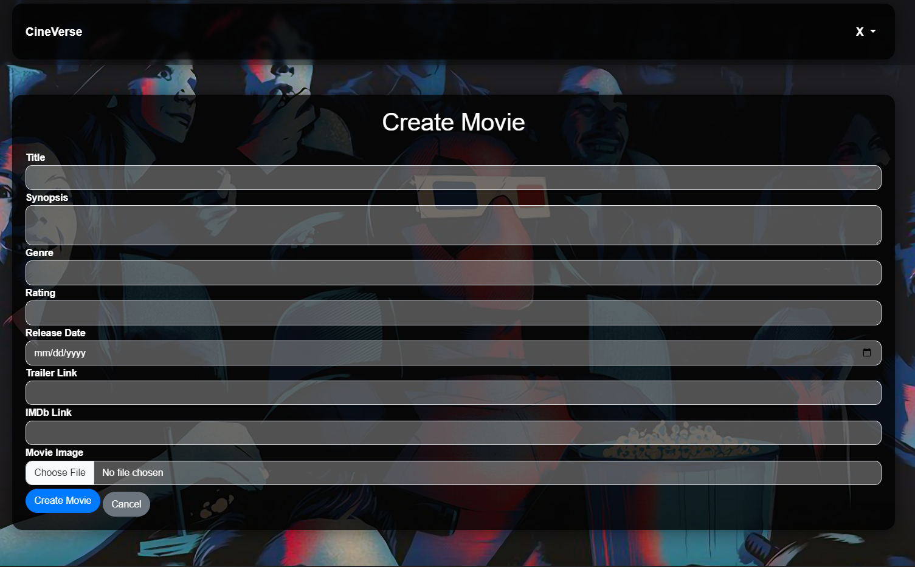

Slide 23
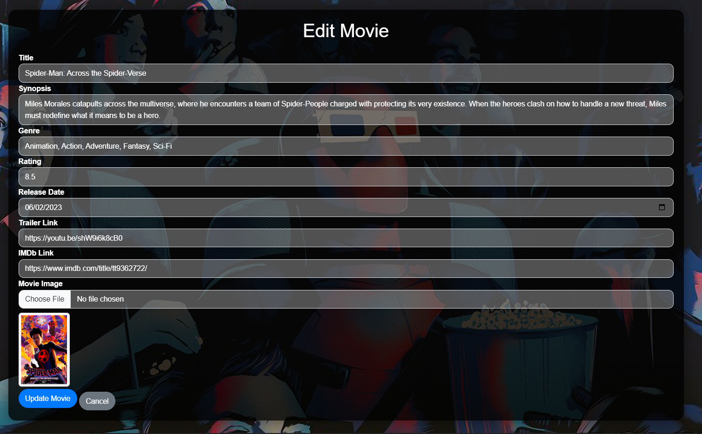

Slide 24
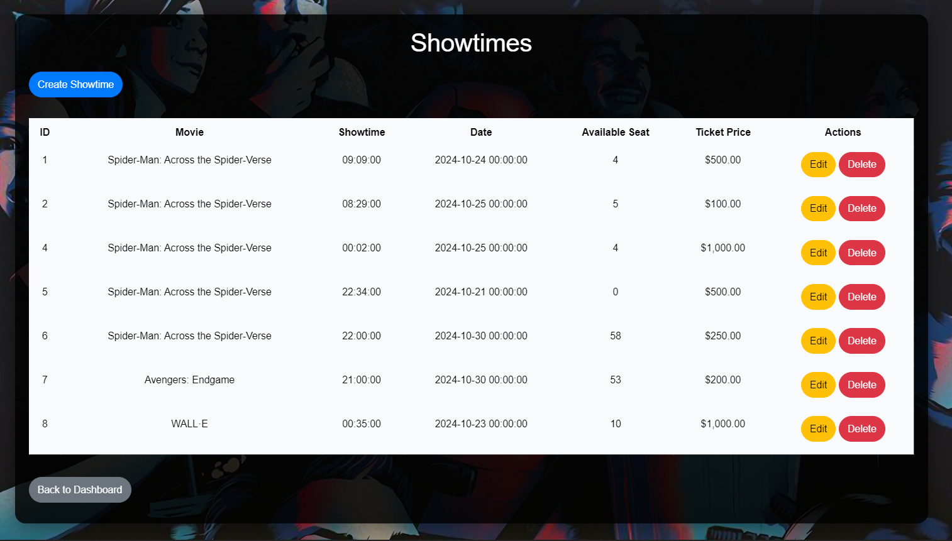

Slide 25
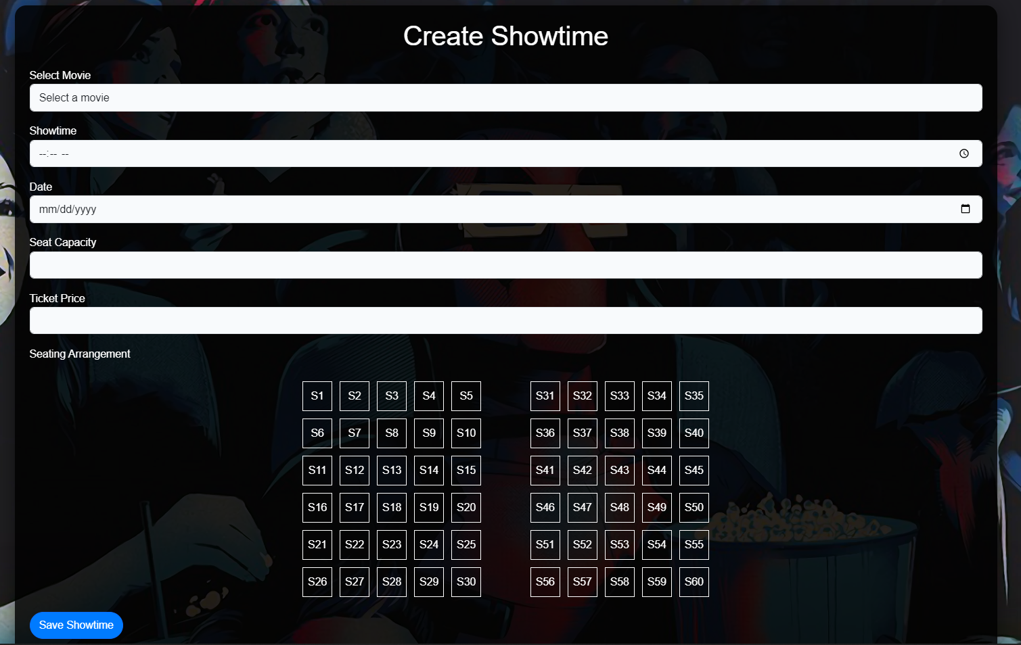

Slide 26
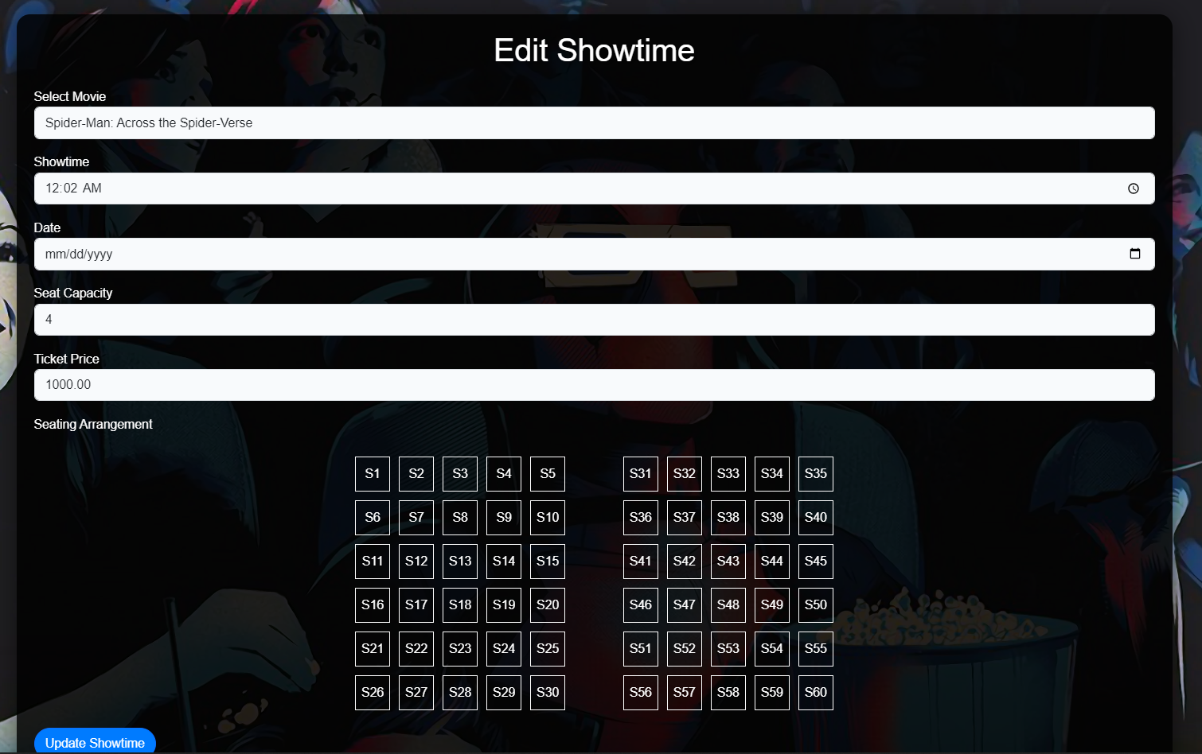

Slide 27
Testing
Unit Testing | Verified individual components like seat selection and booking.
Integration Testing | Ensured seamless interaction between frontend and backend.
System Testing | Checked overall functionality and performance.
User Acceptance Testing | Feedback from users to improve usability.

Slide 28
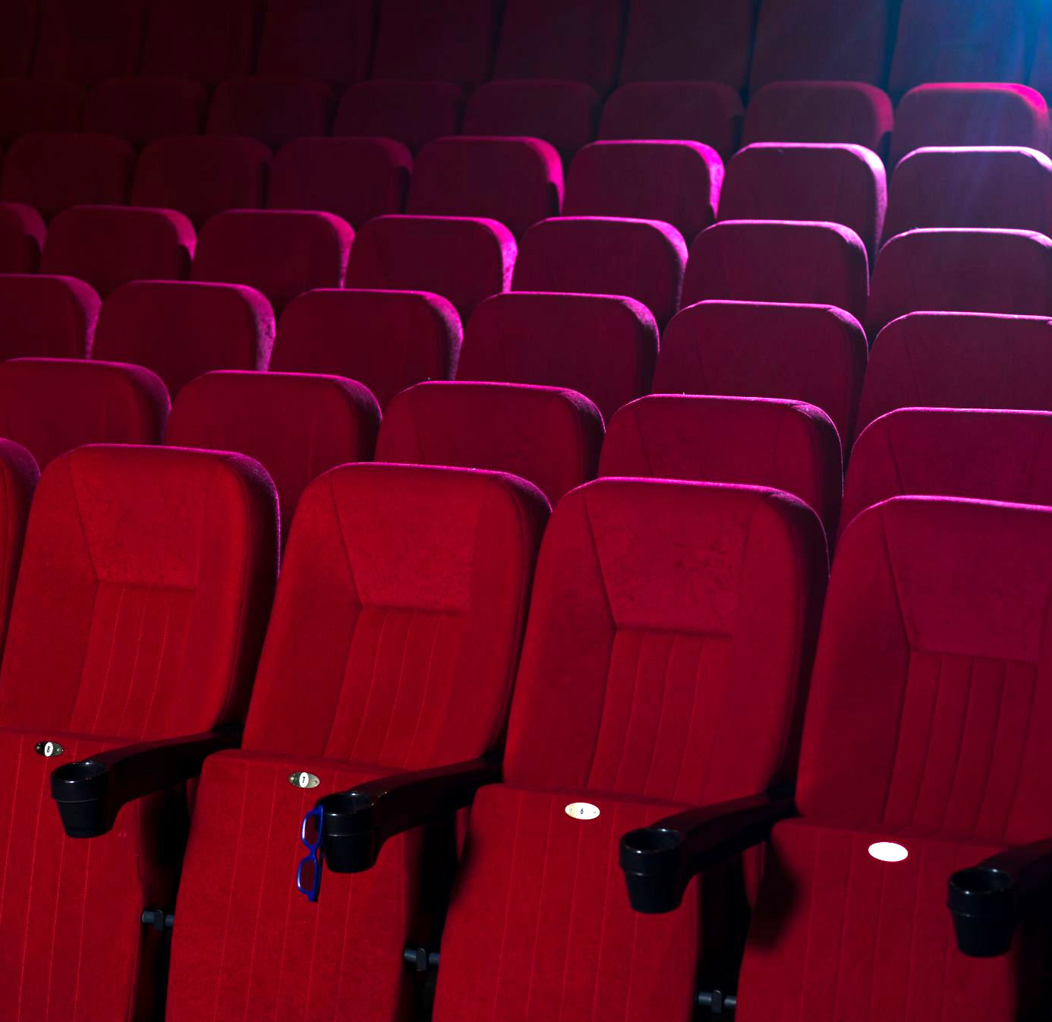
Conclusion
Efficient, seamless online movie ticket booking.
Built with Laravel, JavaScript, and CSS.
Real-time seat selection and admin tools.
Ongoing improvements for better user experience.

Slide 29
Team Contributions
Shovon Kanti Deb Developed the backend API for managing bookings. Coordinated the overall project timeline. Implemented backend security measures. | Poritosh Dey Developed the backend API for managing Built the responsive frontend for movie browsing, seat selection, and booking pages. Optimized frontend performance. Collaborated with the UI/UX designer to ensure design consistency.
Kishore Biswas Designed the UI wireframes and mockups. Conducted user research and usability testing. Led the design and implementation of the seat selection process. | Pranta Nath Designed and optimized the database schema for movies, showtimes, and bookings. Developed APIs for real-time seat selection and booking status.

Slide 30
Thank You

